Slide 1
Computer Organization and Architecture
Exp 3
ALU
Notes:
Before class I need to make sure what you guys think of the experiment. From the feedbacks last semester, we learned that some of the students do not realize what’s the meaning of the class, so I just make a conclusion of this class in my perspective. First, be patient, whether it’s hard or not to you, the experiment need to be a step by step process. Second, the previous exps are prepared for the last one – microcontroller, which I think is the core experiment of the class. When we get to there you will know. So let’s have class begin.

Slide 2
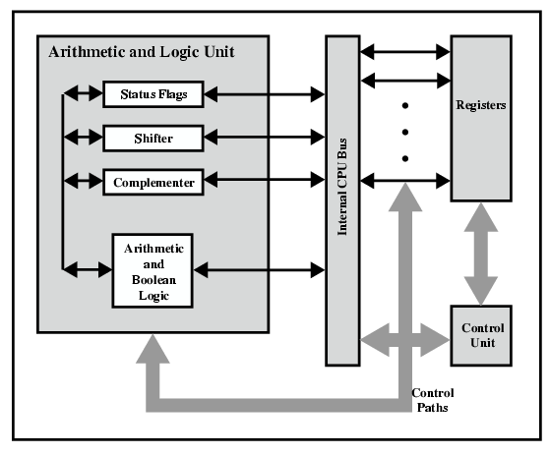
CPU Internal Structure
Transfer data between the various registers and the ALU
Computer: processor, I/O, memory
Processor: control Unit, ALU, register
Notes:
Review of the class, ALU is the most important component in CPU
Consists of four parts.
We will simulate this four functions.

Slide 3
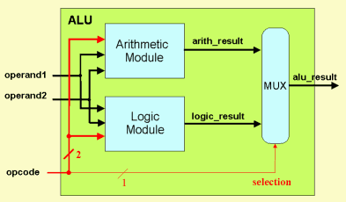
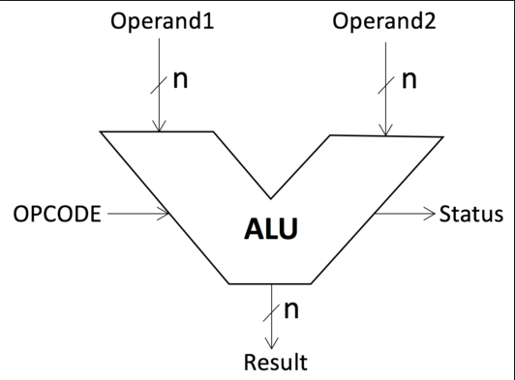
ALU
ALU do the arithmetic and logic operation
at the same time and use MUX to select the
needed result.
In general, ALU has two operands
input and opcode to control the ope-
ration function. It outputs the status and result.
ADD
SUB

Slide 4
Preface
Experiment Purpose
  (1) Know the function and component of ALU(74LS181).
  (2) Know the implementation of basic arithmetic and logical operation;
Experiment content
  Use 74LS181 to excute the signed/unsigned arithmetic and logical operation.

Slide 5
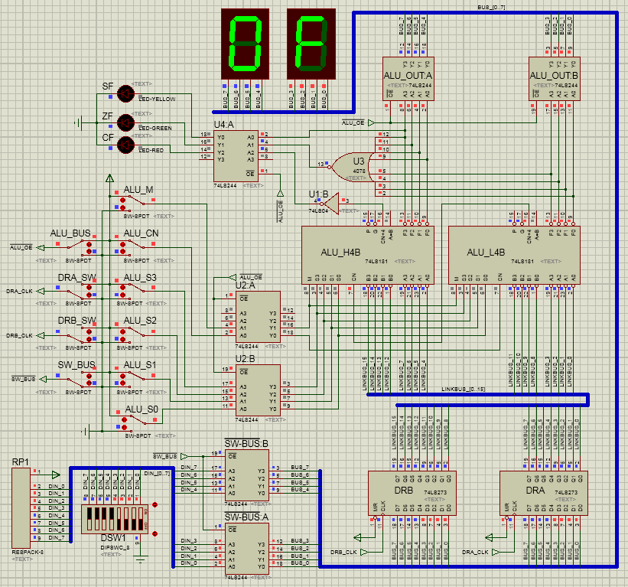
SF:sign flag
ZF:zero flag
CF:carry flag
Output
Buffer
8-bit ALU
control
signals set
Buffer
Buffer
Buffer
Data
register
Input
Buffer
Notes:
2 ALUs cascades with the L4B’s Carry bit output connecting to the H4B’s Carry bit input.
There are also 3 types of sign flags.

Slide 6
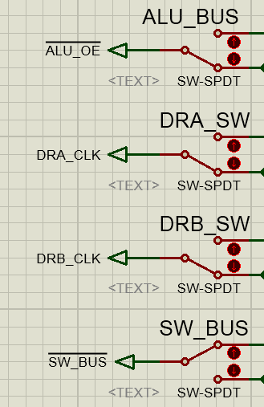
Switchers
signal | function | enabled voltage level
ALU_BUS | send the control signals to ALU | low(manually switch)
DRA_SW | send operand A to ALU | rising-edge voltage(manually switch)
DRB_SW | send operand B to ALU | rising-edge voltage(manually switch)
SW_BUS | enable BUS input | low(manually switch)

Slide 7
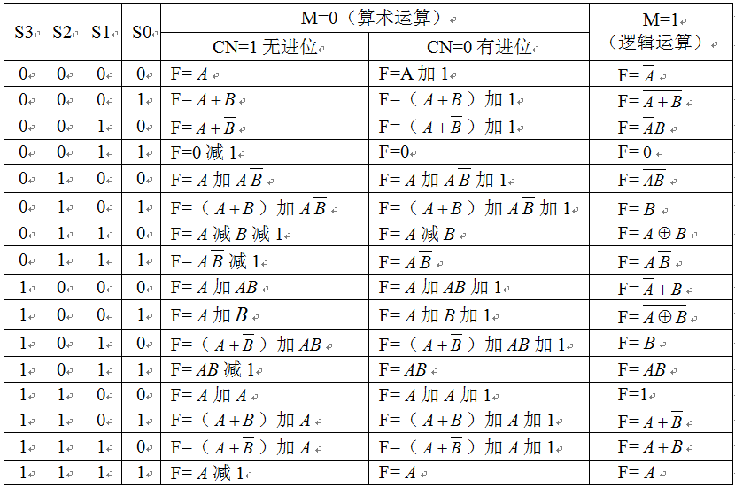
In the table “+” is the logical operation “or”, and “加”, is the arithmetical operation
addtion. For example, “0001” + “0011” = “0011”; “0001” 加 “0011” = “0100”.
Notes:
1.（讲清楚标题行和第一行）
A+B is AorB

Slide 8
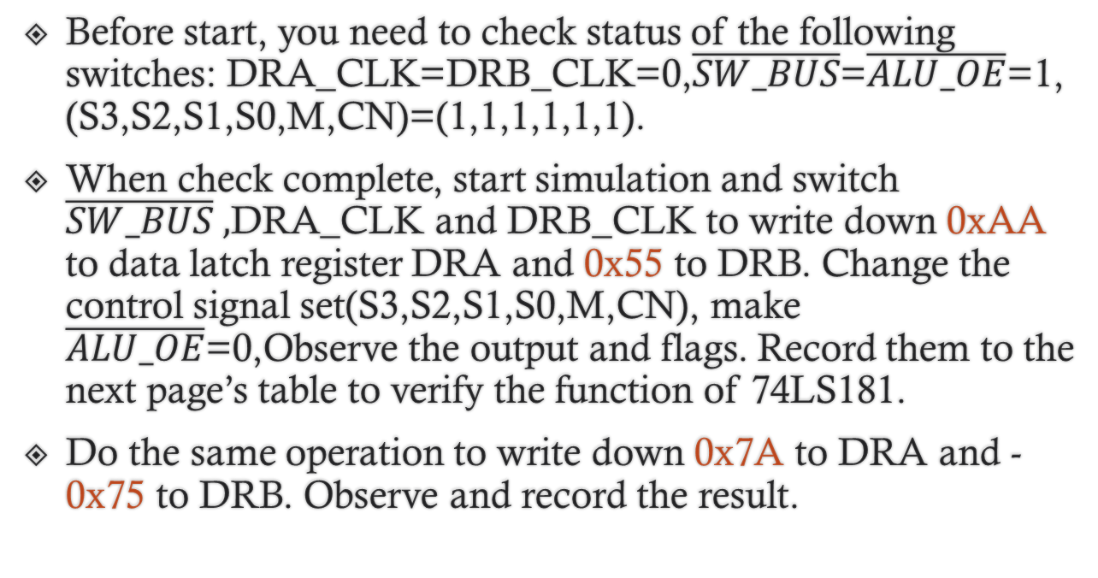
3.Experiment Steps
Before start, you need to check status of the following switches: DRA_CLK=DRB_CLK=0,$\overline{SW_BUS}$=$\overline{ALU_OE}$=1, (S3,S2,S1,S0,M,CN)=(1,1,1,1,1,1).
When check complete, start simulation and switch $\overline{SW_BUS} ,$DRA_CLK and DRB_CLK to write down 0xAA to data latch register DRA and 0x55 to DRB. Change the control signal set(S3,S2,S1,S0,M,CN), make $\overline{ALU_OE}$=0,Observe the output and flags. Record them to the next page’s table to verify the function of 74LS181.
Do the same operation to write down 0x7A to DRA and -0x75 to DRB. Observe and record the result.

Slide 9
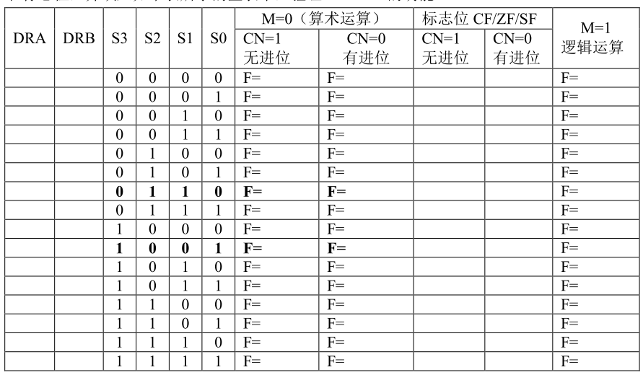
Experimental results

